Slide 1


INTELLIGENT DATA ANALYTICS
PREDICTING CUSTOMER REVENUE
HTTPS://WWW.KAGGLE.COM/COMPETITIONS/2023-IDA-CLASSIFICATION-CHALLENGE/LEADERBOARD

Slide 2

CONTENT
01
PROBLEM STATEMENT
02
GOALS AND OBJECTIVES
03
DATA REPORTS
04
DATA PREPARATION
05
FEATURE SELECTION
06
SUMMARY OF MODEL PERFORMANCE
07
MODEL EVALUATION
08
KAGGLE SCORE

Slide 3




PROBLEM STATEMENT
In many businesses, identifying which customers will make a purchase (and when) and how much will they spend, is a critical exercise. This is true for both brick-and-mortar outlets and online stores. The data provided in this challenge is website traffic data acquired from an online retailer.
The data provides information on customer's website site visit behavior. Customers may visit the store multiple times, on multiple days, with or without making a purchase.
Our goal was to predict how much sales revenue can be expected from each customer. The revenue variable lists the amount of money that a customer spends on a given visit. Our goal is to predict how much money a customer will spend, in total, across all visits to the site for several years.Link for the Dataset is as follows:
https://shorturl.at/sHPZ2

Slide 4





GOALS AND OBJECTIVES
Initial Data Analysis
Data Preprocessing
Bulding Models to Predict
Generating a Data Quality Report of the dataset to determine various parameters like missing value percentage, modes of discrete columns and number of Factor levels
Performing Data Preparation through
missing value imputation and factor level collapsing
Build over 4 Regression models and summarize their performance in a table and choose the best performing model on the basis of their performance metrics, to do the final predictions on Test dataset

Slide 5

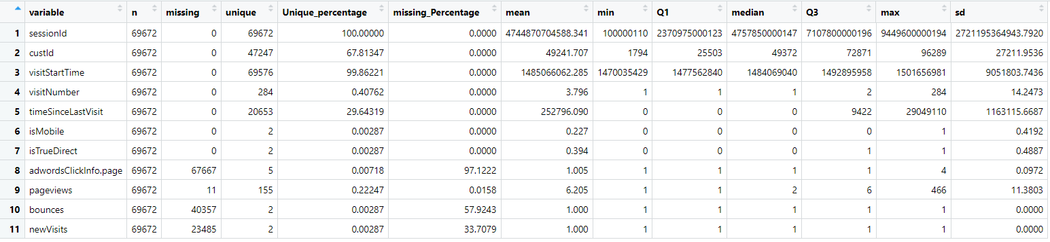
DATA REPORT FOR NUMERIC COLUMNS
From the above quality report we can see we have in total of 11 columns for numeric data.
The report tells you about various statistical parameters for each variable like mean, max, quartiles, standard deviation and,in order to get more clarity on the overall data quality.
We have a few columns with missing data, especially the variables like adwordsClickinfo.page, pageviews, bounces, newvisits which have a higher missing percentage.
Session Id is the Identifier Variable which represents the session in which the customer visits the website.
custID is the unique Identifier variable for each customer.

Slide 6
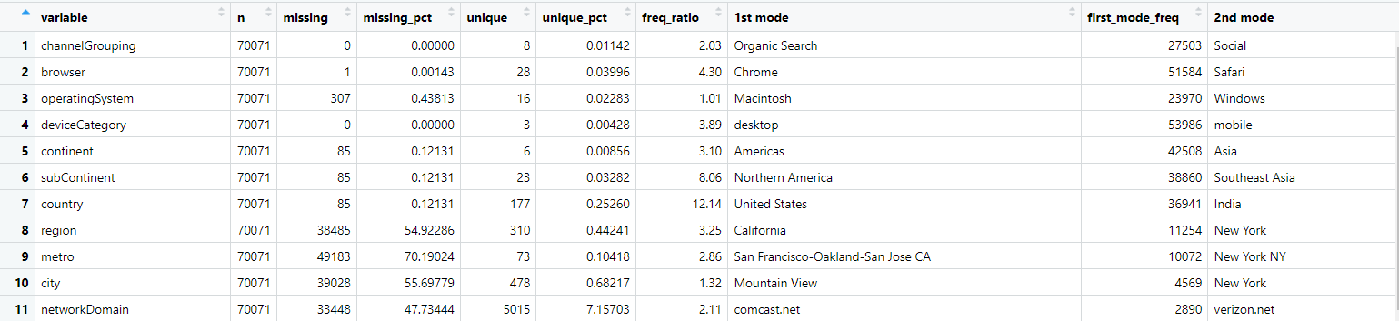
DATA REPORT FOR DISCRETE COLUMNS(1ST 11 COLUMNS)
We have a total of 22 Discrete columns.
Variable ‘region’ metro’,’city’,’networkDomain’ have a huge number of missing values which we needed to deal with.
There are a few columns like ‘NetworkDomain’ and ‘city’ which have a lot of factor levels which we have tried to either collapse or exclude from the model.

Slide 7
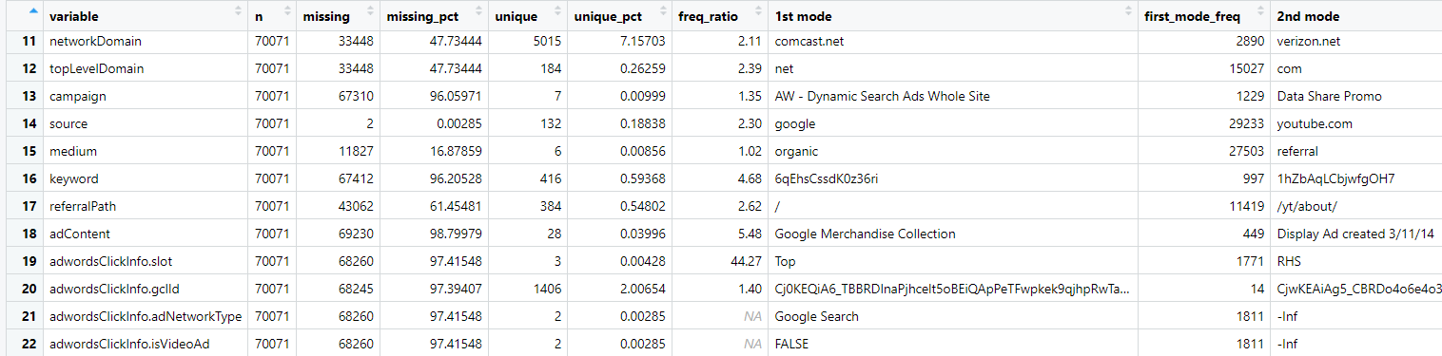
DATA REPORT FOR DISCRETE COLUMNS(NEXT 16 COLUMNS)
Some of the variables, like adcontent, adwordsClickInfo.slot, adwordsClickInfo.gclid,adwordsClickInfo.NetworkType, adwordsClickInfo.VideoAd variance, have huge amount of missing Values.
I decided to remove these variables as they do not contribute a lot of information to the model as they lack a huge chunk of information.

Slide 8
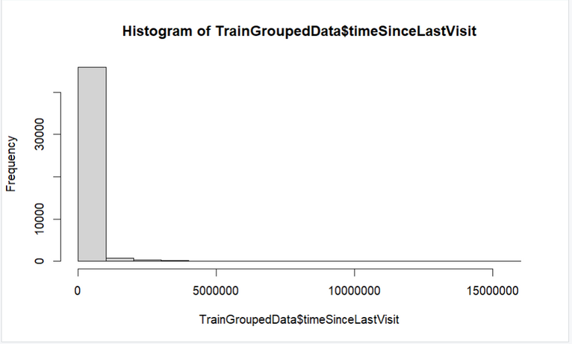

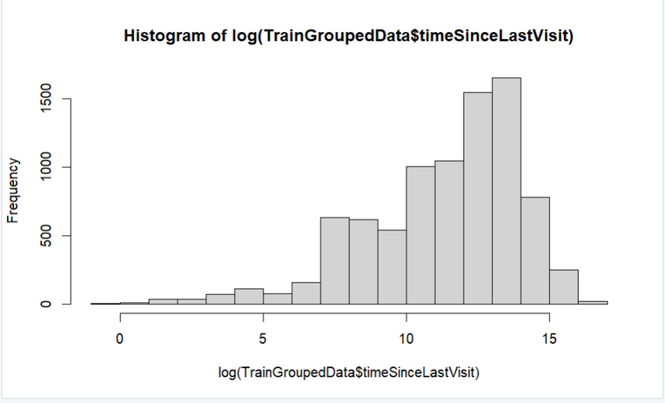
VARIABLE TRANSFORMATION
Pre-Transformation
The figure on the left displays histogram of ‘timesinceLastvisit’ column in the table
The Table is extremely skewed to the left side.
Skewed data can have implications for machine learning models like Bias in Model Training,Poor Generalization,Accuracy Misleading etc.
Post Transformation
The primary purpose of log transformation is to stabilize the variance and make the data more normally distributed .
Some statistical models, such as linear regression, assume that the residuals are normally distributed and have constant variance

Slide 9

Data Preparation
01
02
03
04
REMOVING COLUMNS WITH EXTREME MISSING VALUES
HANDLING MISSING VALUES
FACTOR LEVELS COLLAPSING
TRANSFORMATION OF VARIABLES
I decided to remove all the columns which have more than 90% missing value as they do not contribute a lot of information to the model
We used mean imputation for numeric columns and then for Discrete columns, We used mode imputation for Variables where the percentage of missing values is less than 10%. For any column with a lot of missing values we decided to convert, the NA values to another level of Category
We used fct_collapse function in order to collapse columns like metro, city, networkDomain etc.
Some of the variables had an uneven and extremely skewed distribution, we transformed the variable through log trandofrmation

Slide 10
LIST OF MODELS IMPLEMENTED
01
OLS MODEL
02
PLS MODEL
03
M.A.R.S.
04
LASSO

Slide 11
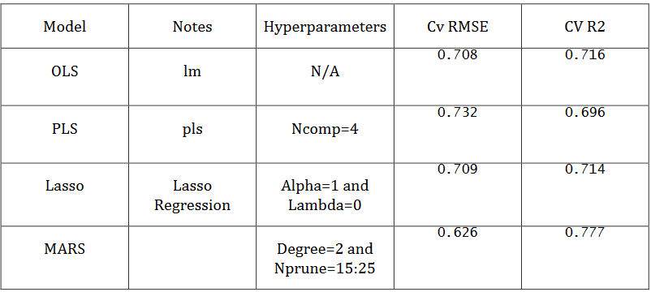
MODEL PERFORMANCE SUMMARY
The below table shows the various model performance summarizations(RMSE,R-Squared)
We choose M.A.R.S to be our preferred model as it had the lowest RMSE among all.

Slide 12

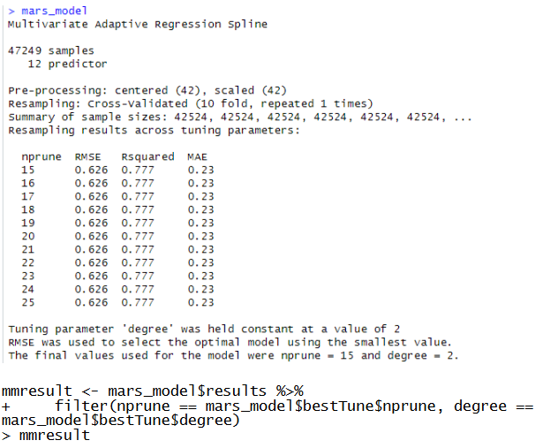
M.A.R.S MODEL
The best RMSE and R2 values are found when using MARS Model.
The data seems to be following a non linear pattern and as MARS is a stepwise model, it was able to capture the variation in training data better than other models.
we used the combination of polynomial terms and categorical variables which reduced the RMSE even further.

Slide 13
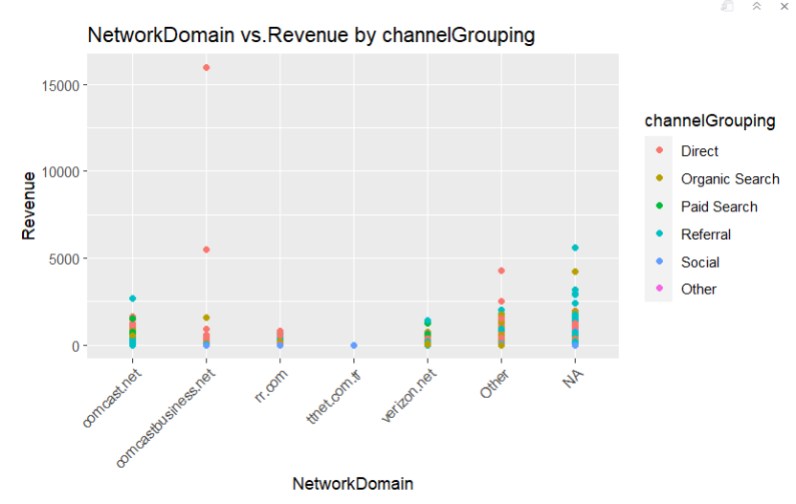
POTENTIAL INSIGHTS FOR THE FIRM TO IMPROVE ITS CUSTOMER REVENUE:
From this graph we can understand how revenue is changing based on network domain the users are using and which channel is widely used.
We can observe in comcast.net network domain most of the users are under Referral channel grouping and if also we can see for almost all the network domains are falling under Direct or Referral channel grouping.
So we can conclude revenue is highest for Direct or Referral channel grouping.
CUSTOMERS

Slide 14
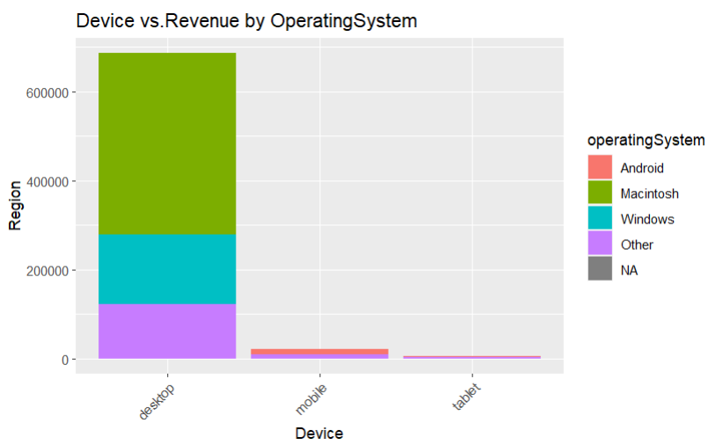
OTHER IMPORTANT INSIGHTS:
Plot is generated for Device vs Revenue for different operating Systems
From this graph we can understand that the revenue is more for Desktop devices especially with Macintosh operating system followed by windows operating system
The least revenue is for
tablet devices
So the company needs to
target users with either a
MAC or windows operating
system as they have a highest
chance of retention.

Slide 15
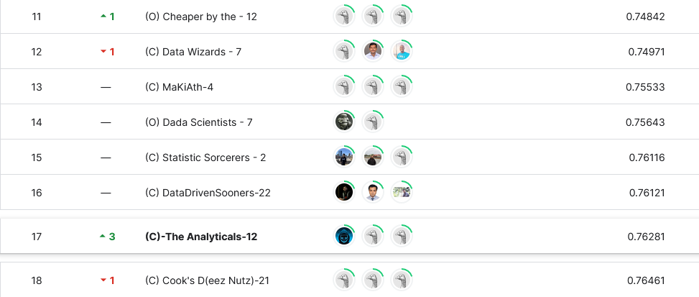
KAGGLE COMPETION SCORE
Our team managed to get a 17th rank among the
32 teams participating in the competition
Our RMSE score was 0.76281
17TH RANK

Slide 16

THANK YOU

